Slide 1
Deep Learning for Natural Language Processing
Nishant Chandra, Ph.D.

Slide 2
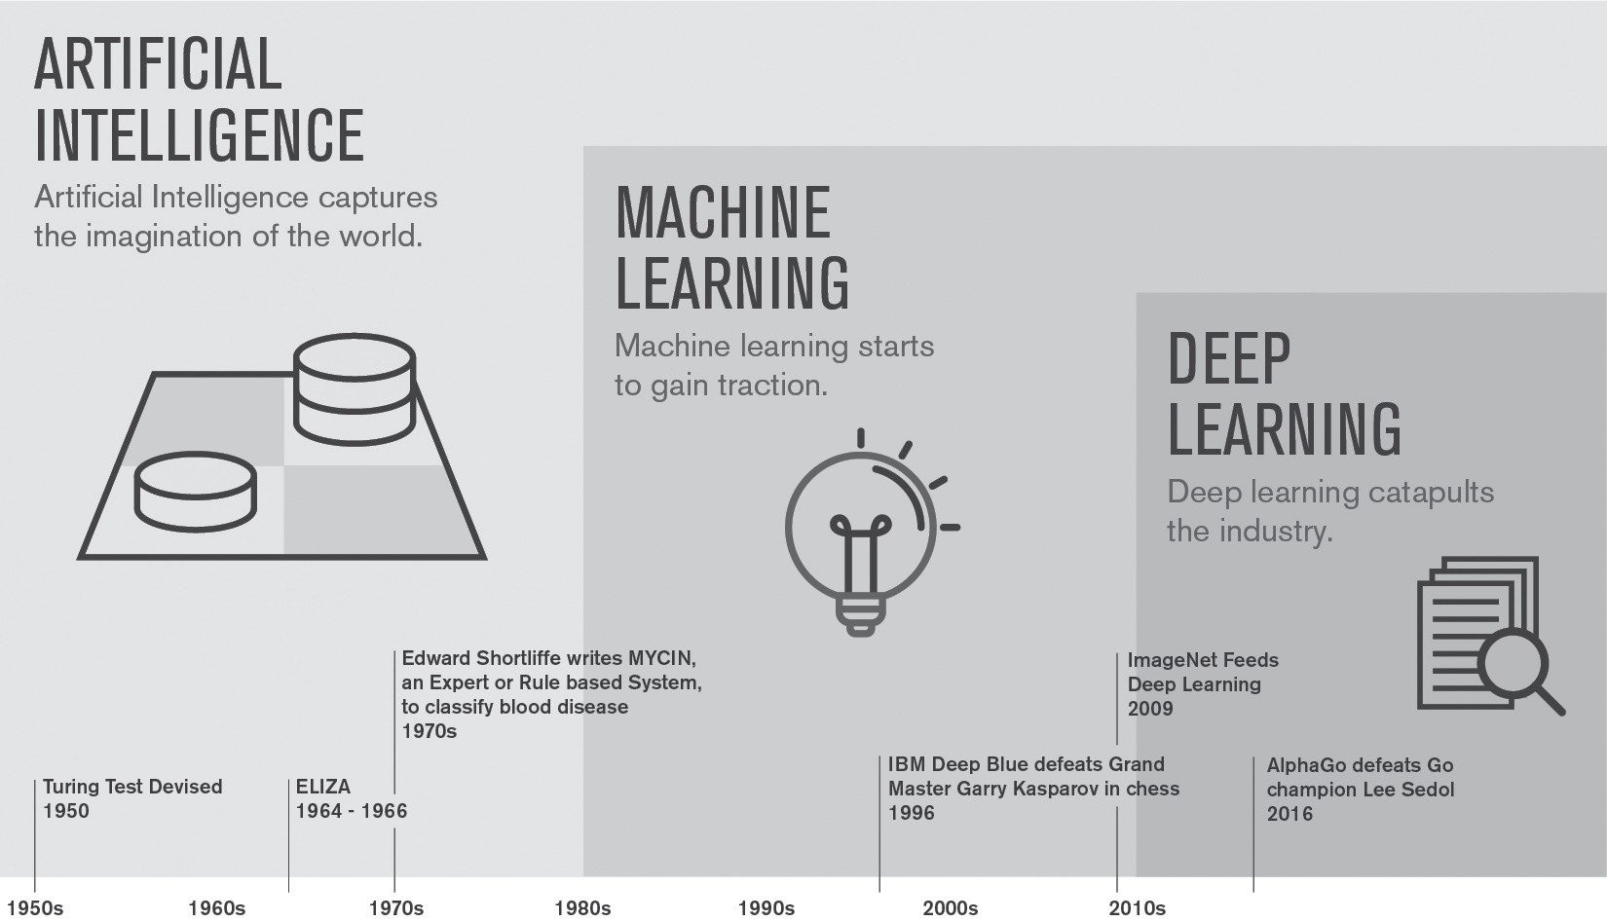

Slide 3
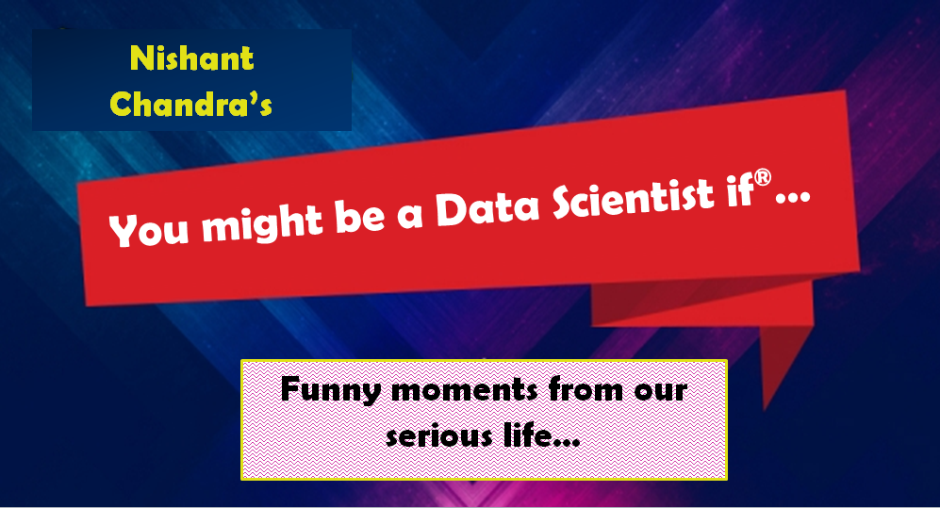
But Before We Get Started…
You might be a Data Scientist if… you believe Natural language processing is a field of Artificial intelligence.

Slide 4
Power of Deep Learning for NLP
Modeling Natural Language Data
Deep Learning Architecture
Intro to NLP
Prog. #1
Foundations of deep learning theory
Deep learning for NLP
Word embedding
Vector space model
Creating word vectors with word2vec
Prog. #2
NLP preprocessing – best practices
Prog. #3
CNNs – Convolution neural networks for sentiment
Prog. #4
RNNs – Recurrent neural networks
Prog. #5
LSTMs – Long short term memory
Prog. #6

Slide 5

What is Natural Language?
Section 1.1
BOT: Extract meaningful Information from natural language
Information extraction – Siri, Alexa, Cortana
Please set up a meeting tomorrow at 10 AM
Temporal sentiment
Categorizing expressed opinions
Contextual summarization
Summarize specific events in a document
Intent classification
Identify topics, trends or actions from large text sources
Machine translation
Translation of language

Slide 6
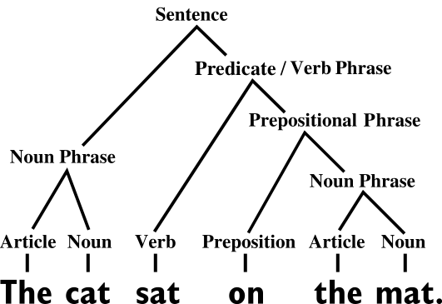
Natural Language Understanding – Classical Model
Lexical analysis
Identifying/analyzing word structure
Syntactic analysis
Semantic analysis
Extract meaning or context
Disclosure integration
Meaning from conversation
Pragmatic analysis
Interpretation or sarcasm

Slide 7
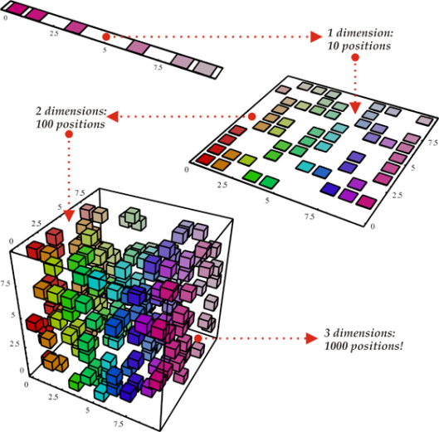
Natural Language Understanding – Classical Model Challenges
Requires representative examples for all relevant variations – Curse of dimensionality
Fragile architecture because of handcrafted feature engineering
Features are often both over specified and incomplete
Same operator is applied repeatedly on different components
“The”, “cat” (noun phrase)
“Sat”, “on”, “the”, “mat” (verb phrase)
Data is unlabeled

Slide 8
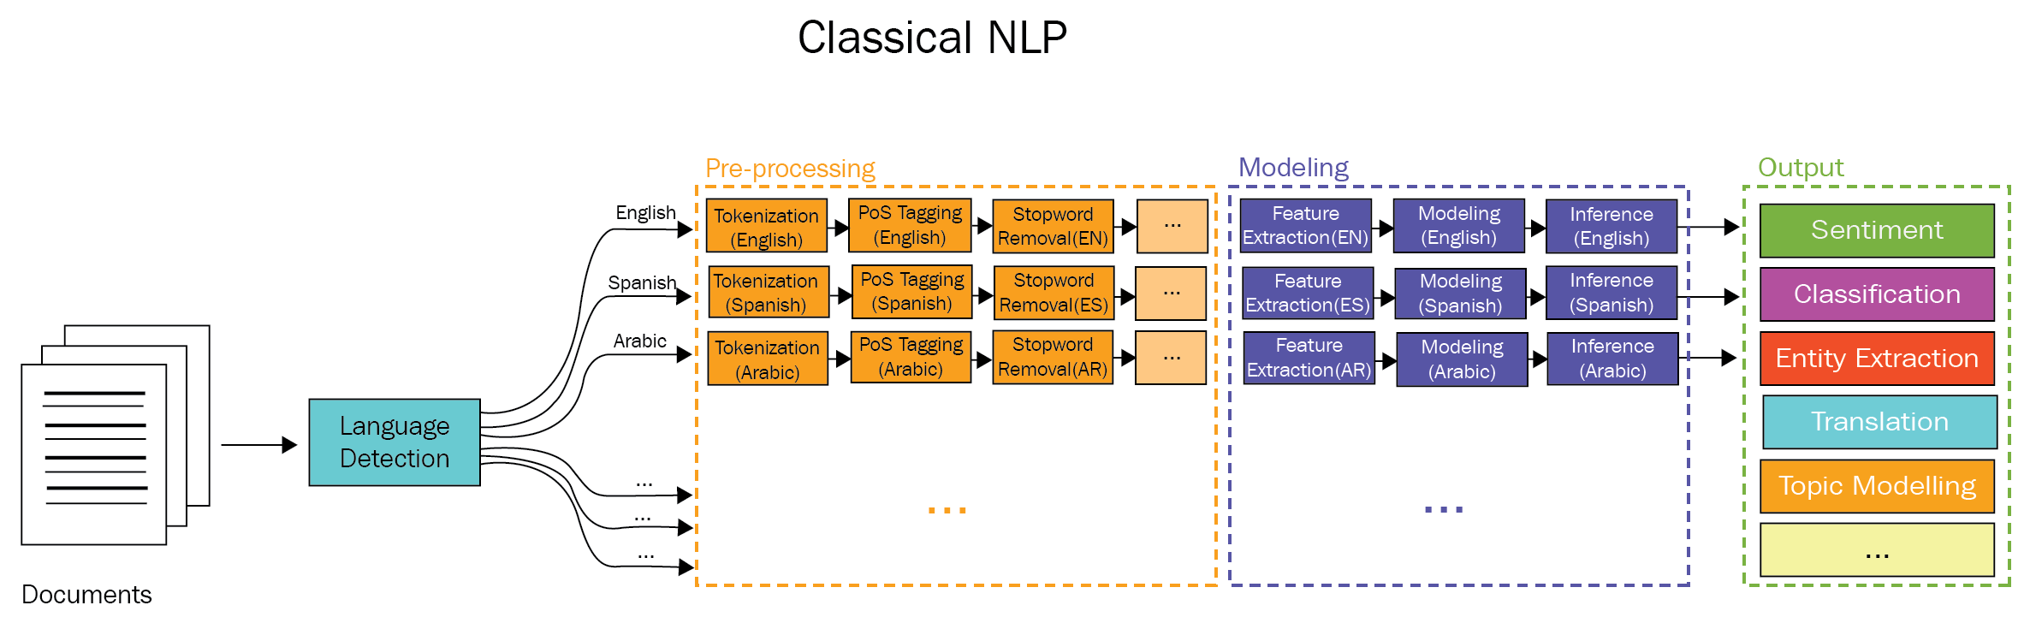
Classical NLP

Slide 9
You might be a Data Scientist if… you understand why Entities are Extracted but Topics are Modeled.

Slide 10

Programming Exercise:
01. Using_NLTK.ipynb
Objective:
Practical examples using NLTK

Slide 11
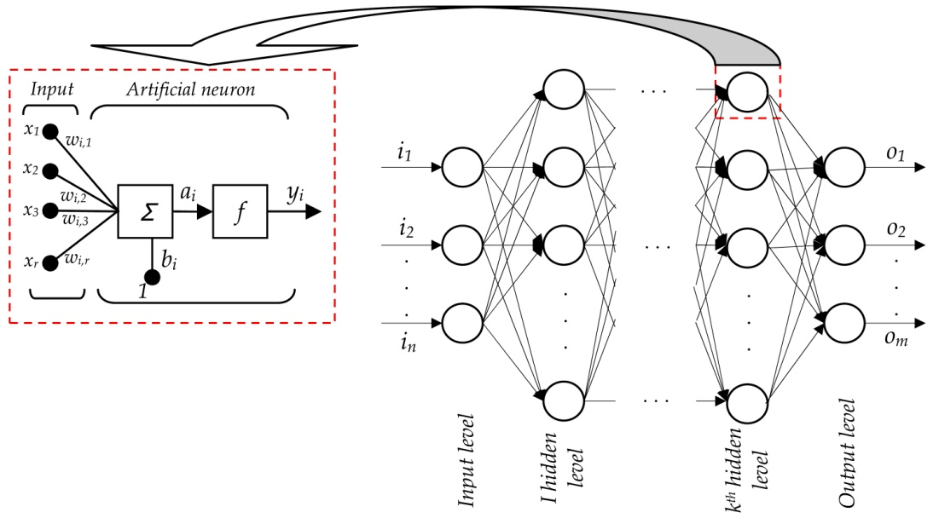
Prerequisite – Deep Learning Theory
Section 1.2
Activation function
Neurons
Cost-function
Gradient descent
Learning
Initialization
Regularization
Layers
Dense
Convolution

Slide 12
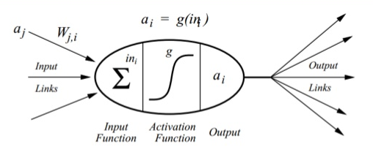
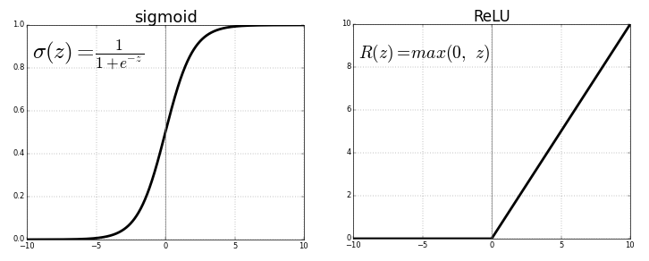
Activation Function
Sigmoid and Tanh
ReLU

Slide 13
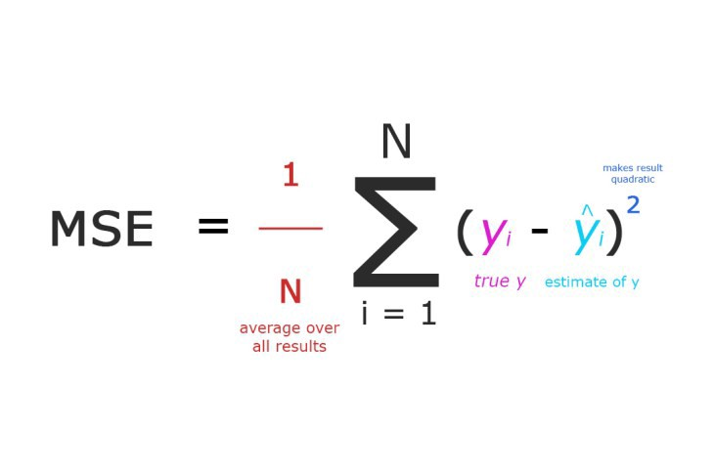
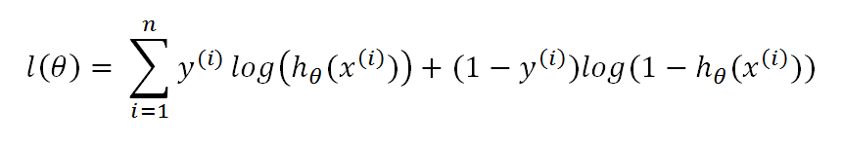
Cost Function
Quadratic
Cross-entropy

Slide 14
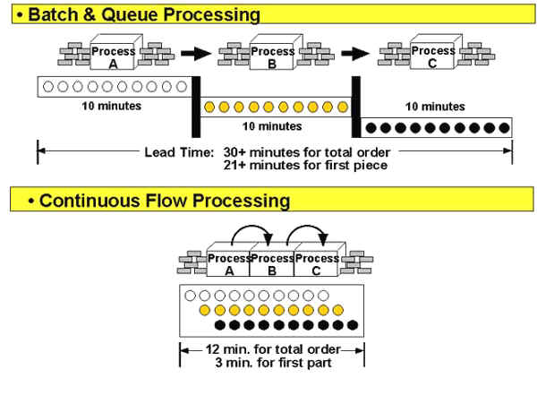
Gradient Descent
Learning rate and Second Order (Adam Optimizer)
Min Batch Size

Slide 15
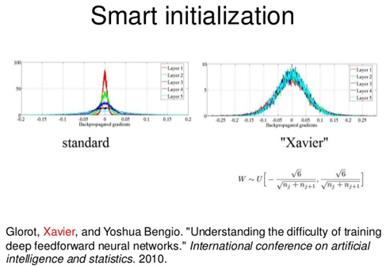
Initialization
Glorot Uniform
Glorot Normal

Slide 16
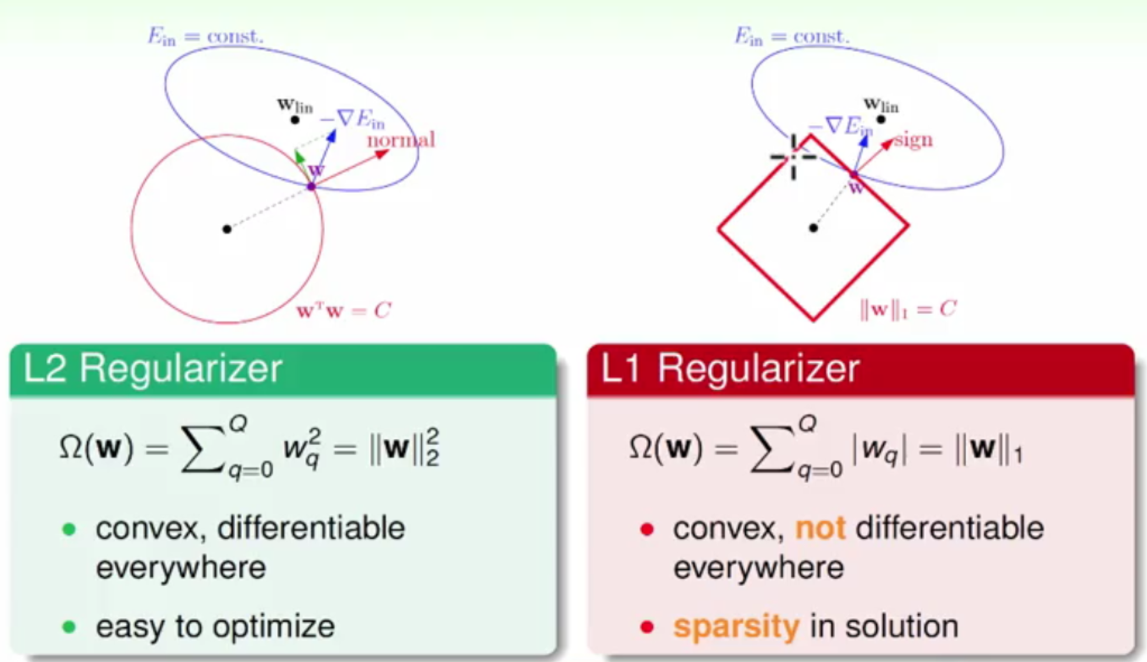

Regularization
Classical (L1/L2)
Deep Learning Specific (Dropout)

Slide 17
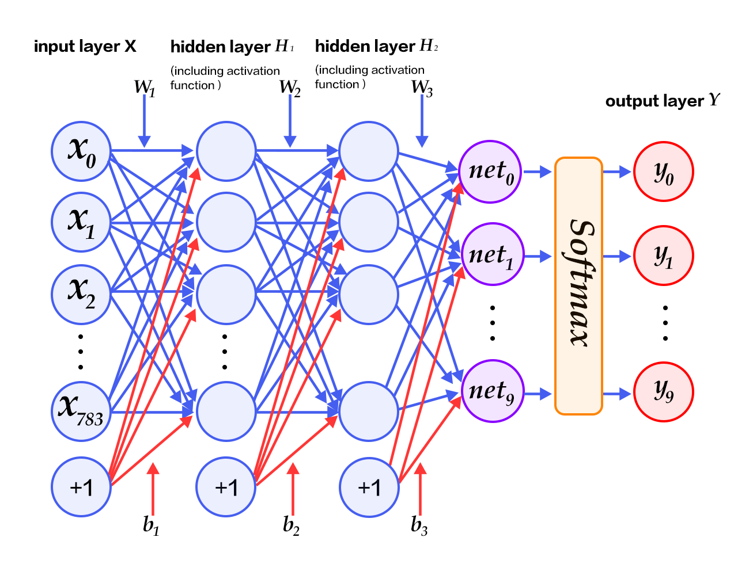
Layers
Dense/SoftMax/MaxPool
Convolution

Slide 18
Deep Learning for NLP
Section 1.3
Technically Representational learning
Learning 3 or more artificial neurons
Successive layers enables
Increasingly abstract representations
Deep Vs. Shallow
Not all models will be deep but will involve ANN
Easy extensibility of a shallow architecture into a deep one
Generally, the theory remains same
Deep learning Vs. traditional machine learning
Make it uniquely powerful approach to natural language processing

Slide 19
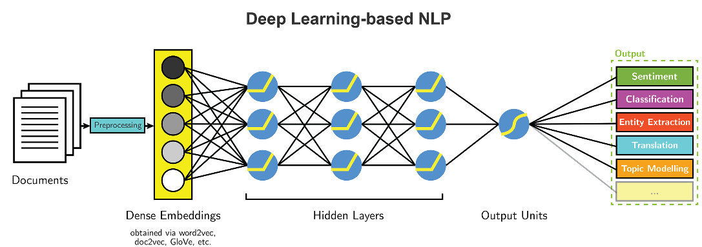
Representational Learning Architecture for NLP

Slide 20
You might be a Data Scientist if… the most frequent word you use is “Deep”.

Slide 21
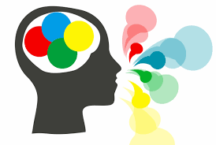
Section 2: Modeling Natural Language Data
Word embedding
Word2Vec
Creating word vectors with word2vec
NLP preprocessing – best practices

Slide 22
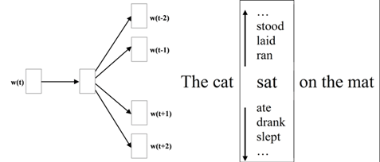
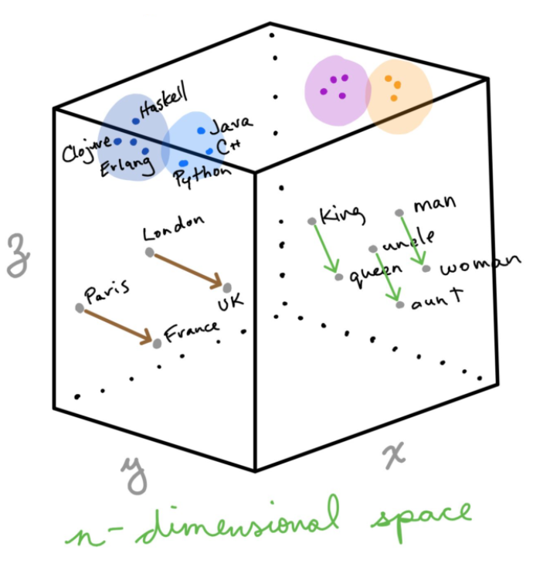
Word Embedding
Section 2.1
Word vectorization model by Tomáš Mikolov (2013, Google)
Pennington , Socher, Manning (2014)
GloVe – similar to Word2Vec in downstream application; parallel implementation; large application
ML algorithms based on neural network referred as deep learning (Word2Vec is rather shallow)
Implement vector space model such that it is independent of training corpus
Also implements Word2Vec, LSI etc. on python

Slide 23
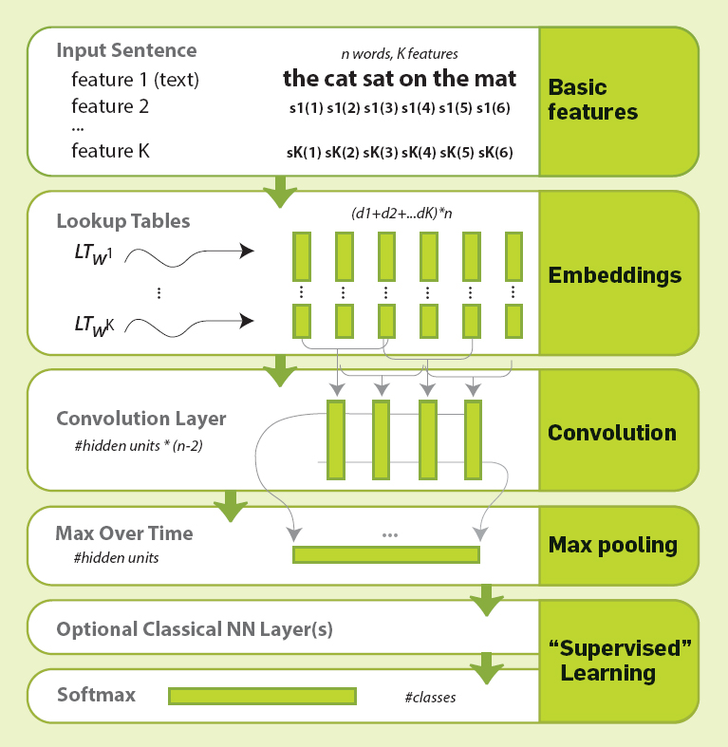
Vector Space Model
Section 2.2
Word vectorization model
Learns relationship between words derived from very large corpus (CBOW & SkipGram)
Vector representation
Finds similar words by finding near neighbors in the vector space using cosine similarity
Uses neural networks to learn vector representation

Slide 24
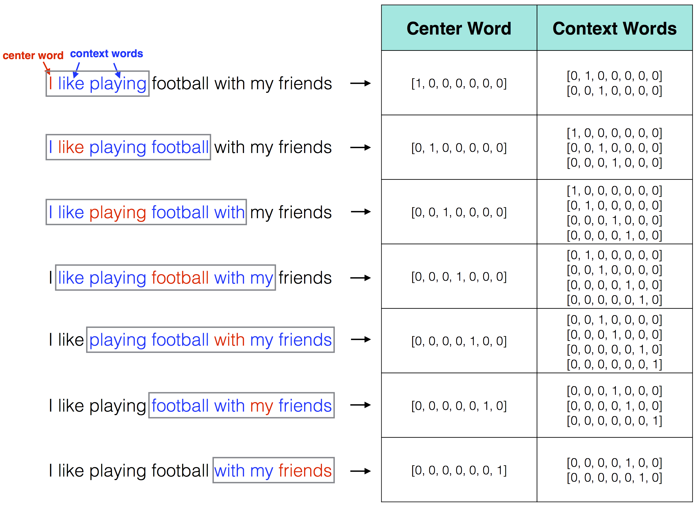
Programming Exercise:
Section 2.3
02.Creating_Word_Vectors_Using_Word2Vec.ipynb
Objective:
Creating Vectors Using Word2Vec

Slide 25
You might be a Data Scientist if… you can project your problems to a higher dimension to find a linear solution.

Slide 26

Short Break…

Slide 27
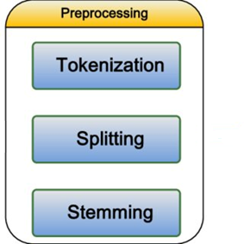
Programming Exercise:
Section 2.4
03.Natural_Language_Preprocessing_Best_Practices.ipynb
Objective:
Stop words
Stemming
Tokenization
Improving Word2Vec

Slide 28
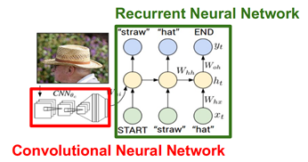
Section 3: Deep Learning Architecture
CNNs – Convolution neural networks for sentiment
RNNs – Recurrent neural networks
LSTMs – Long short term memory

Slide 29
1D CNN for Text Data
Section 3.1
Input - “I like this movie very much!”
Total 7 tokens
Word vectors – chosen to be of length 5
Kernels – 3 kernels of size 2, 3, and 4; repeated twice. Total 6 filters
Convolution - Dot product of word vectors with kernel
Done for each filter
Maxpooling
Softmax

Slide 30
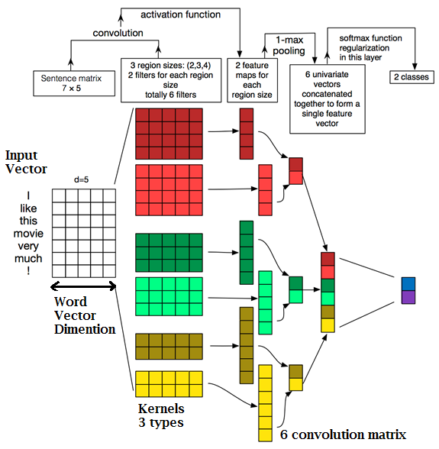

Slide 31
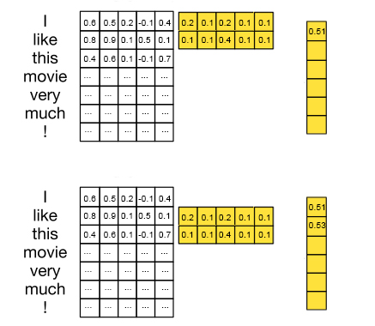
1D Convolution example
Convolution - Dot product of word vectors with kernel
Done for each filter
Resulting in 6 convolution matrix

Slide 32
Networks with convolutional and pooling layers are useful for classification tasks in which we expect to find strong local clues regarding class membership, but these clues can appear in different places in the input. […] We would like to learn that certain sequences of words are good indicators of the topic, and do not necessarily care where they appear in the document. Convolutional and pooling layers allow the model to learn to find such local indicators, regardless of their position.
— A Primer on Neural Network Models for Natural Language Processing, 2015.

Slide 33
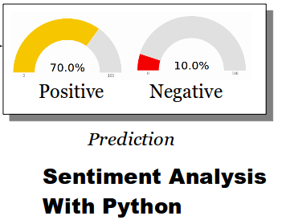
Programming Exercise:
04.Convolutional_Sentiment_Classifier.ipynb
Objective:
Data load and preprocessing
Keras
Design layered CNN
Result interpretation

Slide 34
You might be a Data Scientist if… you wonder that CNN, ANN, and RNN can be simply called as CARnn

Slide 35
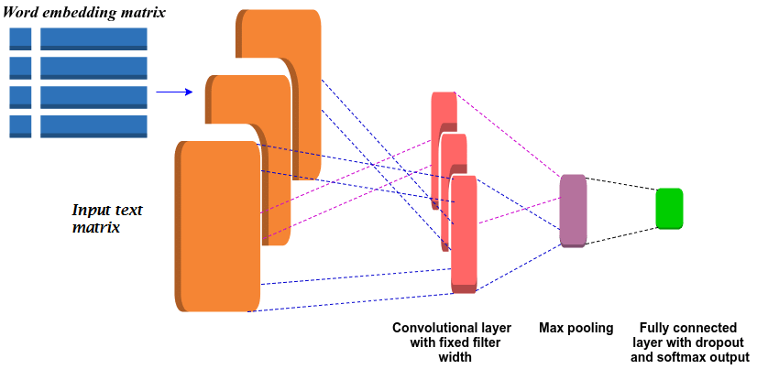
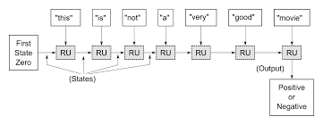
Essential Theory of RNN
Section 3.2
Design of RNN enables to model natural language data better than dense or convolution layers
RNN can take information from strings of words in a sentence
Dense or convolution layers treat words individually and backpropagate error across layers only
RNN not only backpropagate error across layers but also backpropagate through time
Takes previous words into account

Slide 36
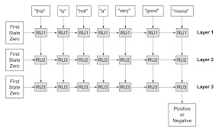
RNN Concrete Idea
Each word is separate input to this RNN
If “very” is current time step, then ‘a’ is (t-1) time step, ‘not’ is (t-2)
At time t, the NN does computation and it passes it to (t+1)^{th} step in the network and also outputs to next layer in the network
The time stamp of each layers match. i.e. time t for layer 1 is same as layer 2
In simple RNNs each node has only a tanh layer
The error is backpropagate through the network layer and also back through time to adjust weights accordingly

Slide 37
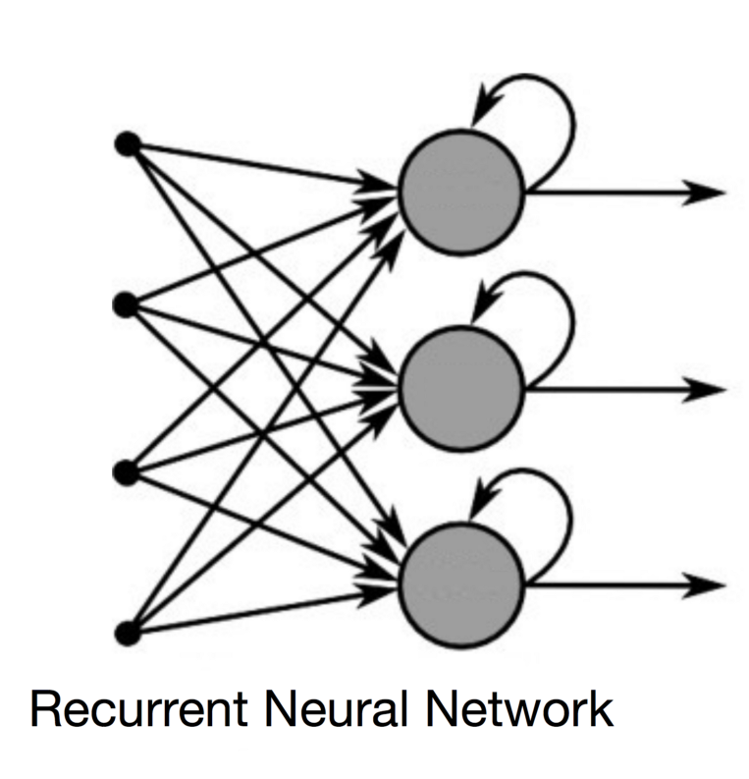
Programming Exercise:
05.Recurrent_Neural_Networks_Sentiment_Classifier.ipynb
Objective:
Design layered RNN
Result interpretation

Slide 38
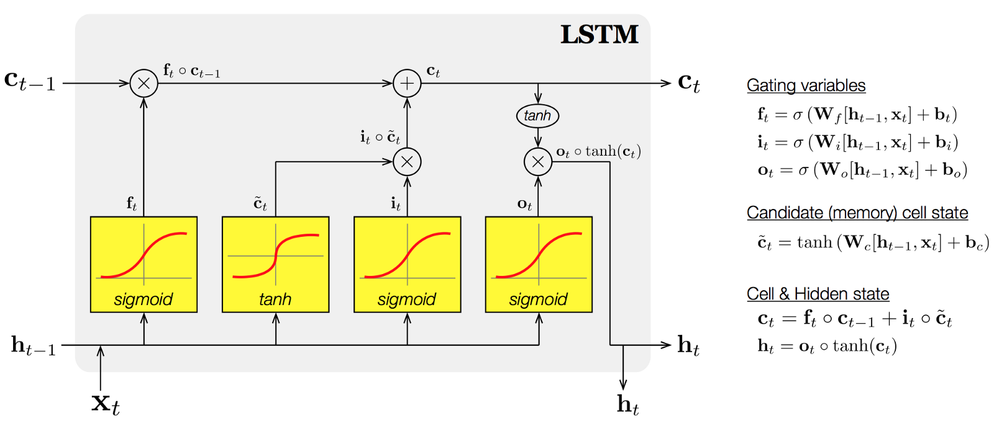
LSTM – Long Shot Term Memory
Section 3.3
They contain gated units which can retain information for a longer time
Forget, input, output gates can retain information, if seems important
Retains conversational context

Slide 39
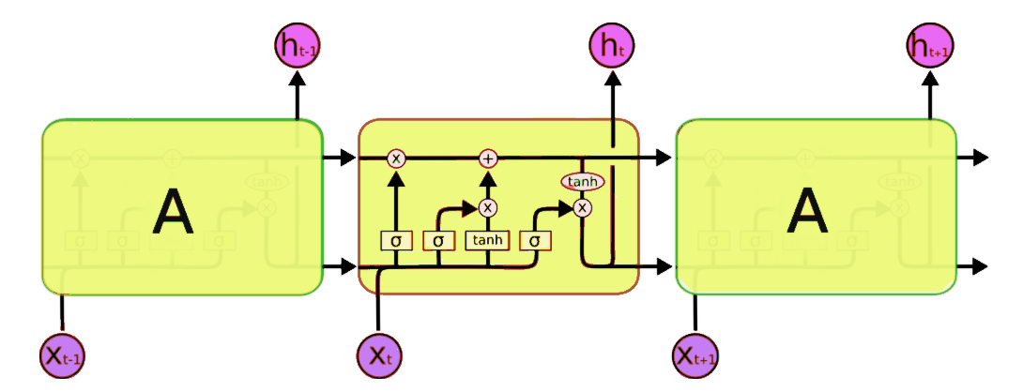
Programming Exercise:
06.LSTM_Sentiment_Classifier.ipynb
Objective:
Design LSTM
Result interpretation

Slide 40
Questions? Comments? Suggestions?
You might be a Data Scientist if… your child’s first words are “Deep”, “Data” or “Model”.
Nish@DrCee.com www.linkedin.com/in/nishant-chandra/

